Slide 1




NEXT GEN EMPLOYABILITY PROGRAM
Creating a future-ready workforce
Team Members
College Name
Student Name :BABITHA A
Student ID : au613021104010
VIVEKANANDHA COLLEGE OF TECHNOLOGY FOR WOMEN

Slide 2

CAPSTONE PROJECT SHOWCASE
Project Title
Notes Sharing Web Application using Django Framework
Abstract | Problem Statement | Project Overview | Proposed Solution | Technology Used | Modelling & Results | Conclusion

Slide 3
Abstract
Key features of the application include user authentication, allowing users to register, log in, and manage their accounts. Overall, the notes sharing web application provides users with a convenient and efficient platform for collaboration and knowledge sharing.The application aims to provide users with a platform to create, manage, and share notes securely over the internet. The application aims to provide users with a platform to create, manage, and share notes securely over the internet.
Source :

Slide 4
Problem Statement
Developing a notes sharing web application using the Django framework to address the need for a secure, user-friendly platform that allows individuals to create, manage, and collaborate on their notes efficiently. This application aims to provide seamless user authentication, intuitive note management features, robust security measures, and scalable performance to enhance the note-sharing experience for users addressing these problem statements will result in a robust and effective notes sharing web application that meets the needs of users while providing a secure and seamless experience.
Source :

Slide 5
Project Overview
The Notes Sharing Web Application project aims to develop a robust platform where users can create, manage, and collaborate on notes securely over the internet. Built using the Django framework, a Python-based web framework, this project encompasses various features and functionalities to enhance the note-sharing experience.
It Provides users with a centralized repository to store their notes securely , accessible from any device with an internet connection. The Notes Sharing Web Application using Django Framework project aims to provide users with a secure, efficient, and collaborative platform for managing and sharing their notes effectively.
Source :

Slide 6
Proposed Solution
The Proposed solution for the Notes Sharing Web Application involves designing and implementing a comprehensive system that addresses the requirements and challenges outlined in the problem statement. Implementing a secure user authentication system and have added some features like login, logout, registering as new user and Searching. The Proposed solution aims to develop a robust notes sharing wed application using python with the Django framework.
Source :

Slide 7
Key Features
User Authentication and Authorization
Note Management
Collaborative Sharing
Security Measures
Scalability and Performance Optimization
User Experience Enhancement
Data Privacy and Compliance
Notification System
Revision History
Backup and Restore
Source :

Slide 8


Technology Used
Front-end
Back-end
Source :

Slide 9
Modelling & Results
Relationships: One-to-many with Note model Users can register for an account with a username, email, and password. Fields: username, email, password, date_joined, last_login Relationships: One-to-many with Note model Authentication system ensures secure access to the application's features. Notes are stored securely in the database and associated with the user who created them. Users can update, delete, and organize notes into folders. Sharing options include granting view-only or edit access to shared notes. Collaborators can leave comments or suggestions on shared notes.
Source :

Slide 10
Homepage

Slide 11
About-Us-Page

Slide 12
Login Page

Slide 13
Files Uploading Page

Slide 14
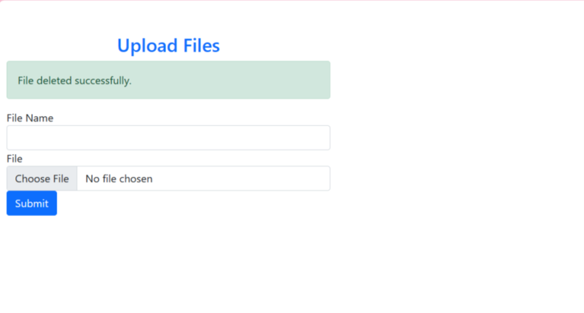
Files Deleting Page

Slide 15
Future Enhancements:
Multi-Language Support: Add support for multiple languages and localization features to cater to users from diverse linguistic backgrounds.
Analytics and Insights: Incorporate analytics tools to provide users with insights into their note usage patterns, such as most frequently accessed notes, collaboration metrics, and user engagement statistics.
Mobile Application: Develop a companion mobile application for iOS and Android platforms, providing users with native access to the notes sharing platform and offline access to their notes.
Gamification and Engagement Features: Introduce gamification elements such as badges, achievements, and leaderboards to encourage user engagement and participation in collaborative activities.
Voice Recognition and Dictation: Incorporate voice recognition and dictation features to enable users to create and edit notes using speech input.

Slide 16
Conclusion
The Notes Sharing Web Application using the Django framework serves as a valuable tool for individuals and teams seeking an efficient and collaborative platform for managing their notes securely. Through continuous improvement and iteration based on user feedback and emerging technologies, the application is poised to remain a trusted solution for note-sharing needs in the digital age.
Additionally, the project lays the foundation for future enhancements and innovations to further enhance the functionality and value of the application.
Source :

Slide 17
Thank You!
Notes:
Thank You !!

